Slide 1
Spring in 60 Seconds

Slide 2

“The only thing that will keep your developers happy is to make them feel productive”
- Rob Mee, Pivotal

Slide 3

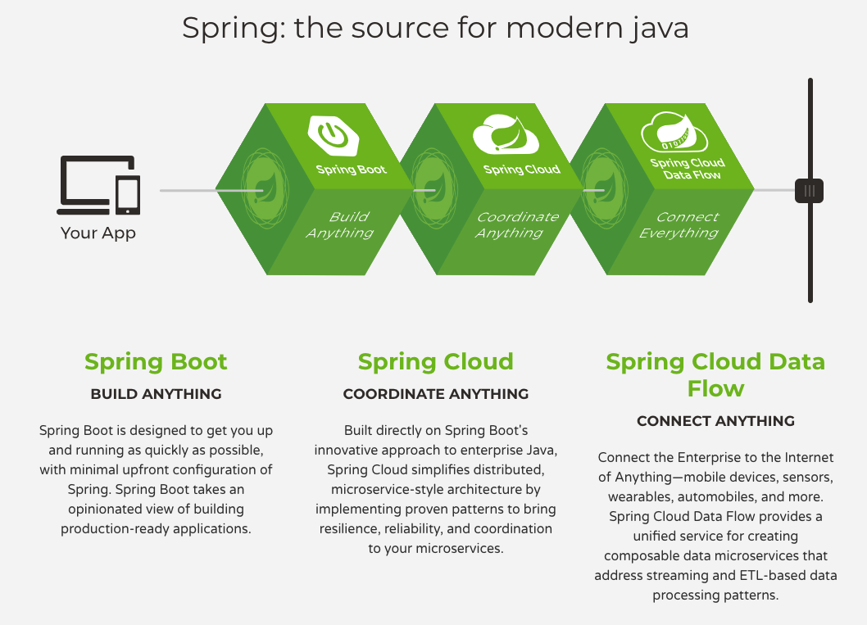
What is Spring?
The best Java application development framework
Productive Accomplish practically any Java development task Simple, fully comprehensive and modular Deployable / testable / portable Clear and well documented with great online guides
Popular 4 in 10 Java developers use Spring Boot (JVM Mag) There’s over 3m visits to Spring Initializr every year Permissive Open Source License (Apache 2.0) Vibrant, passionate & committed community
Trusted World’s #1 IoC / Dependency Injection Framework Proven in production since 2004 enterprise distribution & commercial support available
Notes:
Spring is that lighter weight Java that began to erode the app server market in 2004, and helps straddle that world with the 3rd generation, cloud native platforms.
It even helps 2nd generation customers stuck on older versions of Java EE take advantage of newer Java EE features on their exact same server, often with an upgrade to their server.
Spring is the #1 enterprise Java application development framework by almost any measure. Why do millions of developers choose Spring?
Projects…
Spring AMQP
Spring Batch
Spring Boot
Spring Cloud
Spring for Apache Hadoop
Spring Data Commons
Spring Data KeyValue
Spring Data JPA
Spring Data MongoDB
Spring Data Gemfire
Spring Data Redis
Spring Data REST
Spring Data Solr
Spring Framework
Spring HATEOAS
Spring Integration
Spring LDAP
Spring Kerberos
Spring REST Docs
Spring Retry
Spring Statemachine
Spring Security
Spring Security OAuth
Spring Social
Spring Social Facebook
Spring Social Twitter
Spring Social LinkedIn
Spring Web Services
Spring XD
Spring Cloud Data Flow
Spring Shell
Spring IO Platform
Spring Session
Spring Tool Suite

Slide 4

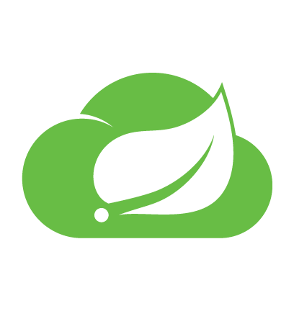

Spring’s Game Changers...
Build Anything
Coordinate Anything
Connect Anything
Spring Cloud Data Flow
Cloud native connectors and data orchestration pipelines for the most common integration scenarios
Stream & batch processing
Host on TAS & K8s
Simple Spring Flow UI
Metrics, Health, Insights
And more...
Spring & Spring Boot
The world’s #1 enterprise Java application development framework and the leading quickstart microservices engine
IoC / Dependency Injection
AOP, Data, Transactions
HTTP, REST, Reactive, Sockets
Build, Test, Integrate, Run
Instrumentation, Scheduling
And more...
Spring Cloud
Simple and accessible programming model for the most common distributed systems and microservice patterns
Service Discovery
Config Management
Circuit Breakers
Gateways, Tracing
AWS, GCP, AZure, K8s
And more...
INCLUDES
INCLUDES
INCLUDES

Slide 5

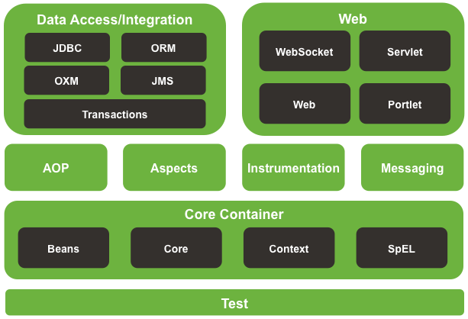
Build: Spring Framework
Spring Framework
Enterprise Java application patterns in modular libraries
A rich, fully integrated developer toolbox… 🔐 OAuth2, Kerberos, SAML 🔌 REST, MVC, HATEOAS, Sockets, SOAP 🔎 JDBC, JPA, noSQL, Search 📬 Batching, scheduling, messaging, caching 📱 Mobile, iOS & Android ⏰ Reactive, asynchronous, synchronous ✅ Testing, AOP, expressions, metrics… ☕ Java, Groovy, Kotlin
Notes:
Spring is that lighter weight Java that began to erode the app server market in 2004, and helps straddle that world with the 3rd generation, cloud native platforms.
It even helps 2nd generation customers stuck on older versions of Java EE take advantage of newer Java EE features on their exact same server, often with an upgrade to their server.
Spring is the #1 enterprise Java application development framework by almost any measure. Why do millions of developers choose Spring?
Accomplish any task: support for REST, Web, Websocket, Integration, Batch and Reactive applications
Simplified development: Simple getting started experience requiring minimal configuration
Proven Track Record: In production since 2002, with a focus on maintaining backward compatibility, used heavily by Cloud pioneers and Fortune 2000
Trusted: Java developers rely on Spring for their most demanding applications
Testable: Write clean, testable code against the infrastructure components of your choice
Curated and Modular: Curated set of dependencies while keeping developers in full control of deploying only the parts they need
Deployable: runs on premise, or in public and private cloud platforms
Permissive license: OSS, Apache 2.0 licensed

Slide 6
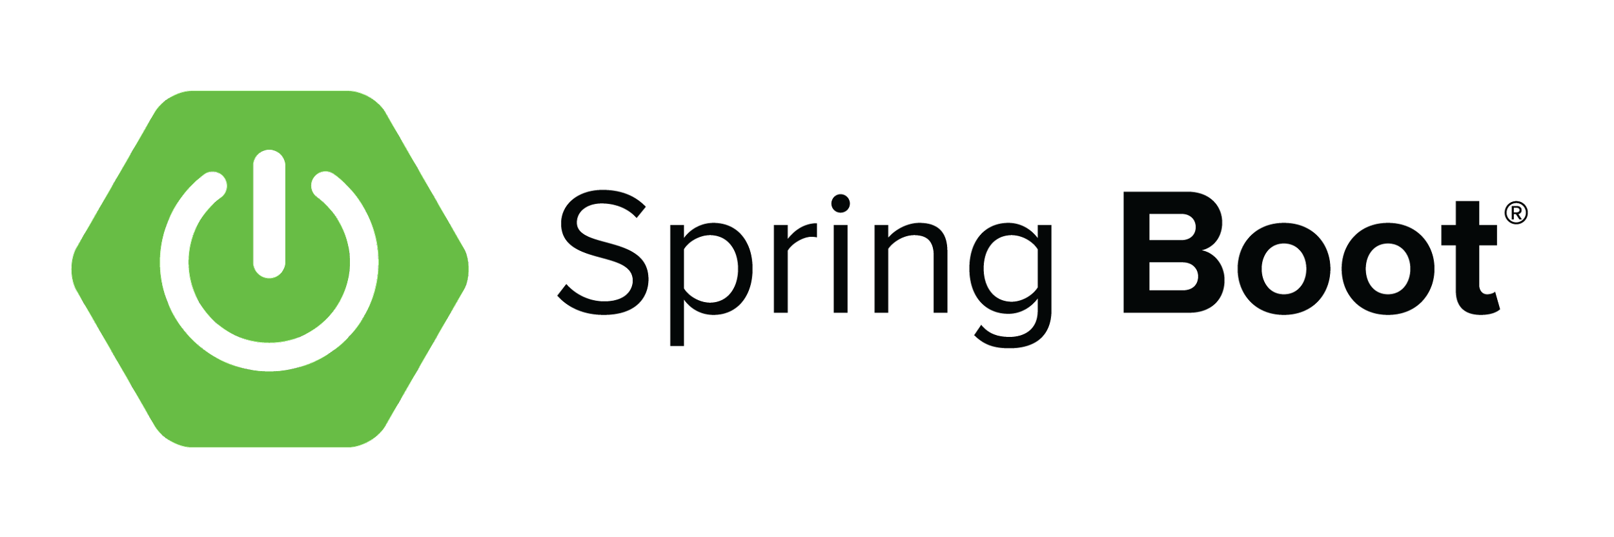
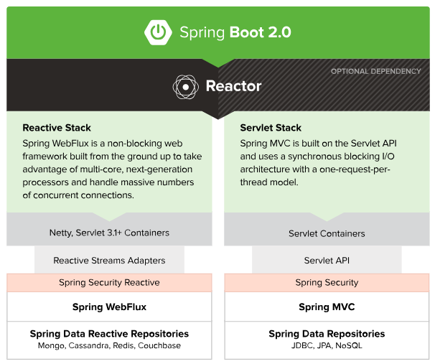

Build: Spring Boot
Quickstart application context and microservice container
Fast Convention-over-configuration, no XML, no code generation, autoconfigure everything
Opinionated But flexible - gets out of the way quickly if you want to change the defaults
Portable Convenient executable JAR packaging Ready to run with an embedded servlet engine
Production ready Works out of the box. Integrated with Cloud Foundry. Observable “Actuators” for health, metrics etc. Polyglot (Java, Spring, Groovy, Kotlin)
Notes:
Spring is that lighter weight Java that began to erode the app server market in 2004, and helps straddle that world with the 3rd generation, cloud native platforms.
It even helps 2nd generation customers stuck on older versions of Java EE take advantage of newer Java EE features on their exact same server, often with an upgrade to their server.
Spring is the #1 enterprise Java application development framework by almost any measure. Why do millions of developers choose Spring?
Accomplish any task: support for REST, Web, Websocket, Integration, Batch and Reactive applications
Simplified development: Simple getting started experience requiring minimal configuration
Proven Track Record: In production since 2002, with a focus on maintaining backward compatibility, used heavily by Cloud pioneers and Fortune 2000
Trusted: Java developers rely on Spring for their most demanding applications
Testable: Write clean, testable code against the infrastructure components of your choice
Curated and Modular: Curated set of dependencies while keeping developers in full control of deploying only the parts they need
Deployable: runs on premise, or in public and private cloud platforms
Permissive license: OSS, Apache 2.0 licensed

Slide 7
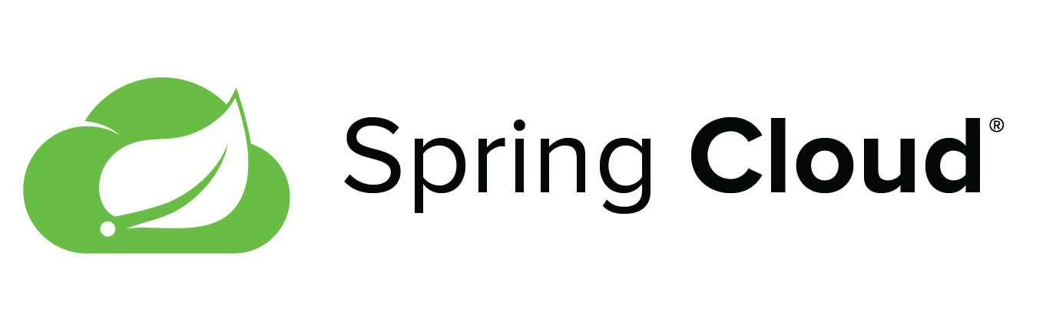
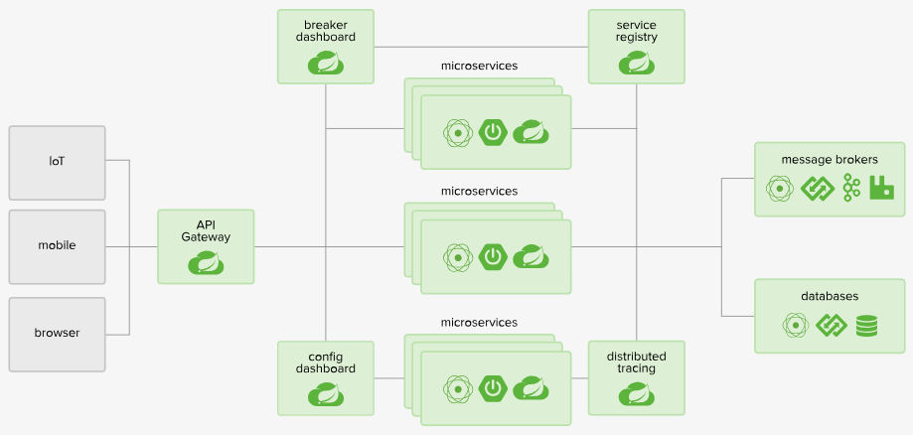
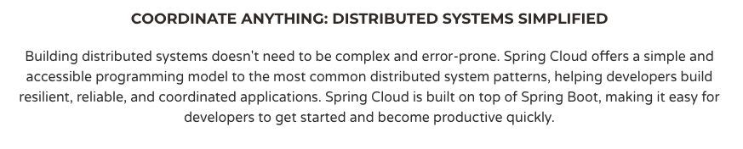

Coordinate: Spring Cloud
Distributed application coordination patterns
Runtimes and client libraries for...
Service Discovery
Configuration Management
Circuit Breakers
API Gateways
Intelligent Client Side Routing
Distributed Tracing
Tasks, API Contracts, Streams
….and much more
Connectors for CF, AWS, GCP, Azure, K8s
Also available as TAS Marketplace Services
Steeltoe extends SCS client access to .Net!
Notes:
Building distributed systems doesn't need to be complex and error-prone. Spring Cloud offers a simple and accessible programming model to the most common distributed system patterns, helping developers build resilient, reliable, and coordinated applications. Spring Cloud is built on top of Spring Boot, making it easy for developers to get started and become productive quickly.
Spring Cloud OSS provides the It’s platform aware and provides an integrated spectrum of opinions, convention over configuration
Building on Spring Boot and Spring Security OAuth2 we can quickly create systems that implement common patterns like single sign on, token relay and token exchange.
configuration management, service discovery, circuit breakers, intelligent routing, micro-proxy, control bus, one-time tokens, global locks, leadership election, distributed sessions, cluster state).

Slide 8
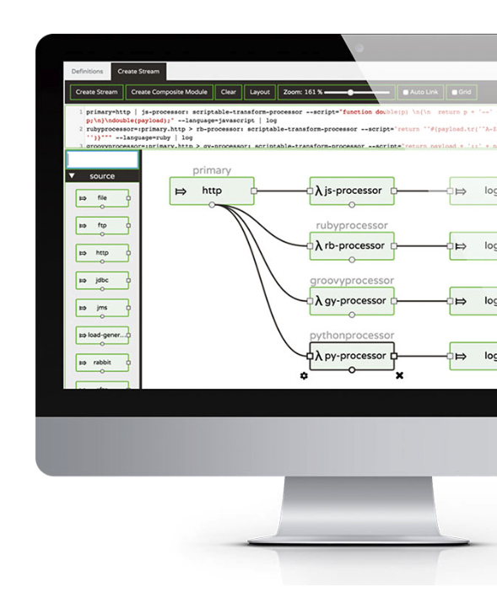
Connect: Spring Cloud Data Flow
Data composition patterns for spring boot
Fast, Scalable & Cloud Native Supports stream and batch processing
Flexible & Powerful Ingest, transform, analyze, and store all your data
Connect all the things FTP, RDBMS, Cassandra, Kafka, RabbitMQ, GemFire, Redis, and much more
Host anywhere Tanzu Application Server or K8s
Intelligent insights metrics, health checks, and remote management
Spring Flo is a visual designer UI for Spring Cloud Data Flow which assists in the simple creation of both stream and batch pipelines
Notes:
CONNECT ANYTHING
Spring Cloud Data Flow makes it easy to build and orchestrate cloud-native data pipelines for use cases such as data ingest, real-time analytics, and data import/export. Spring Cloud Data Flow makes it simple to connect systems by providing out of the box connectors for the most common integration scenarios.
-
Supports processing data in real-time streams and batch
-
Ingest, transform, analyze, and store data
-
Connectors for FTP, RDBMS, Cassandra, RabbitMQ, GemFire, Redis, and much more
-
Supports modern messaging middleware: Kafka and RabbitMQ
-
Spring Flo visual designer for pipelines
-
Operational dashboard: metrics, health checks, and remote management
-
Supported platforms: Cloud Foundry, Kubernetes, Apache YARN, and Apache Mesos

Slide 9
Spring Boot Basics

Slide 10


“Working with Spring Boot is like pair-programming with the Spring team.”
- Josh Long @starbuxman

Slide 11
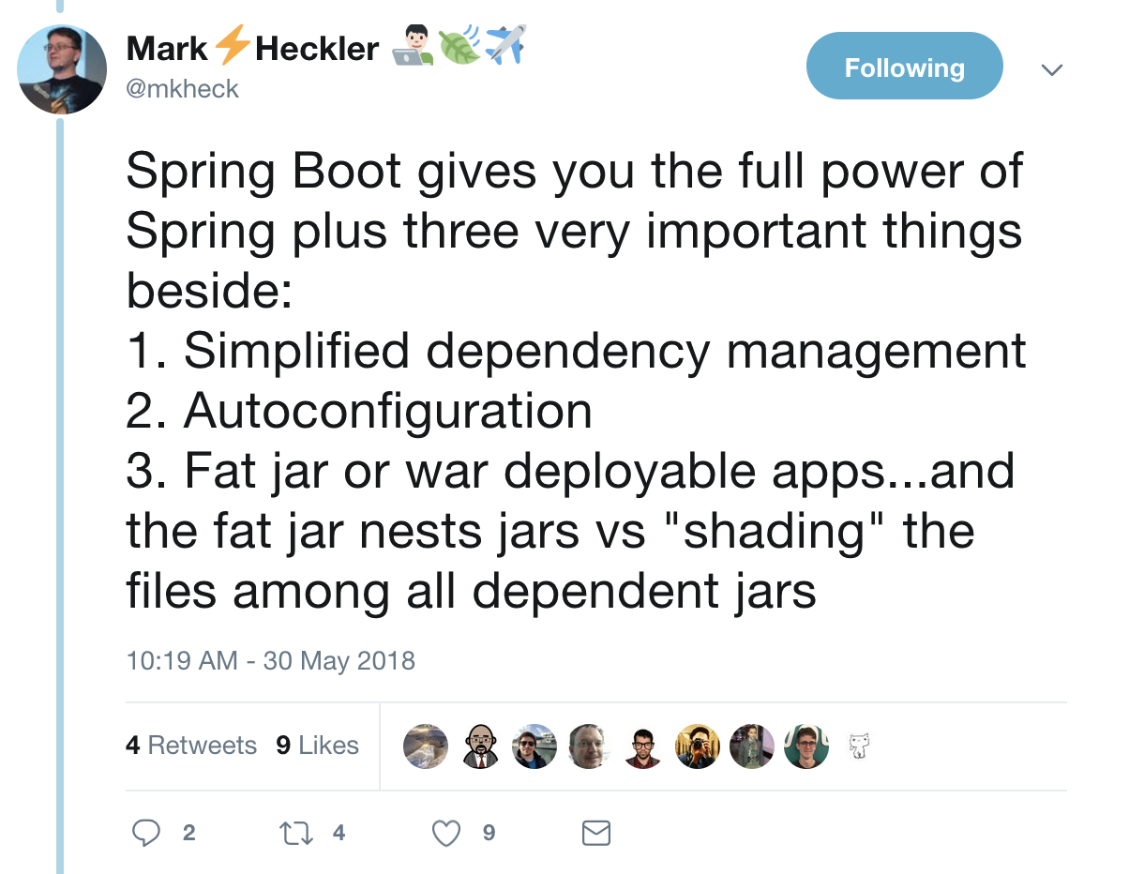
https://twitter.com/mkheck/status/1001875166660644866

Slide 12
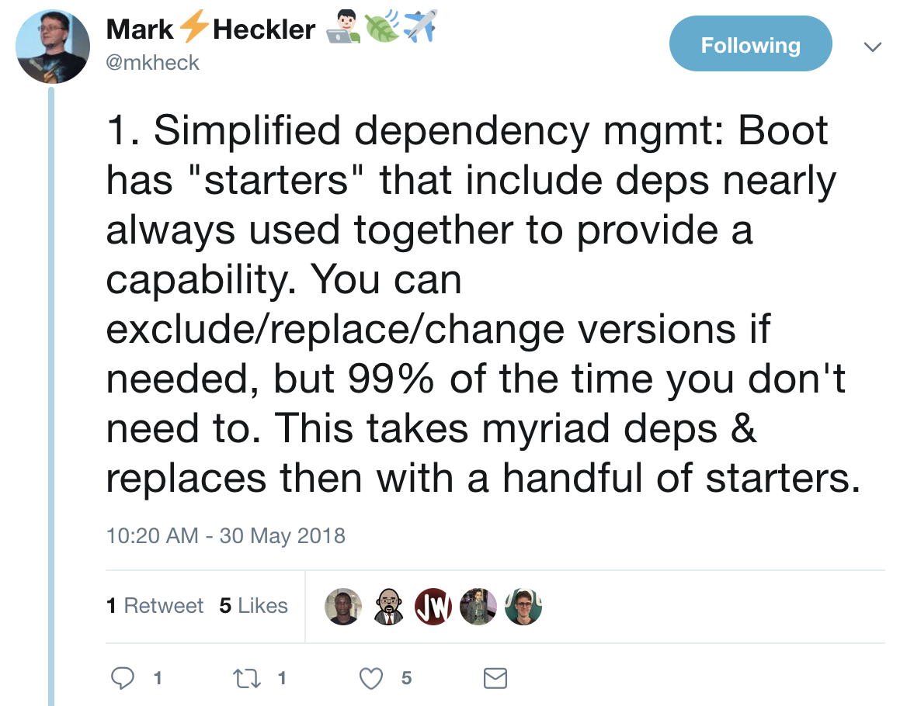

Slide 13
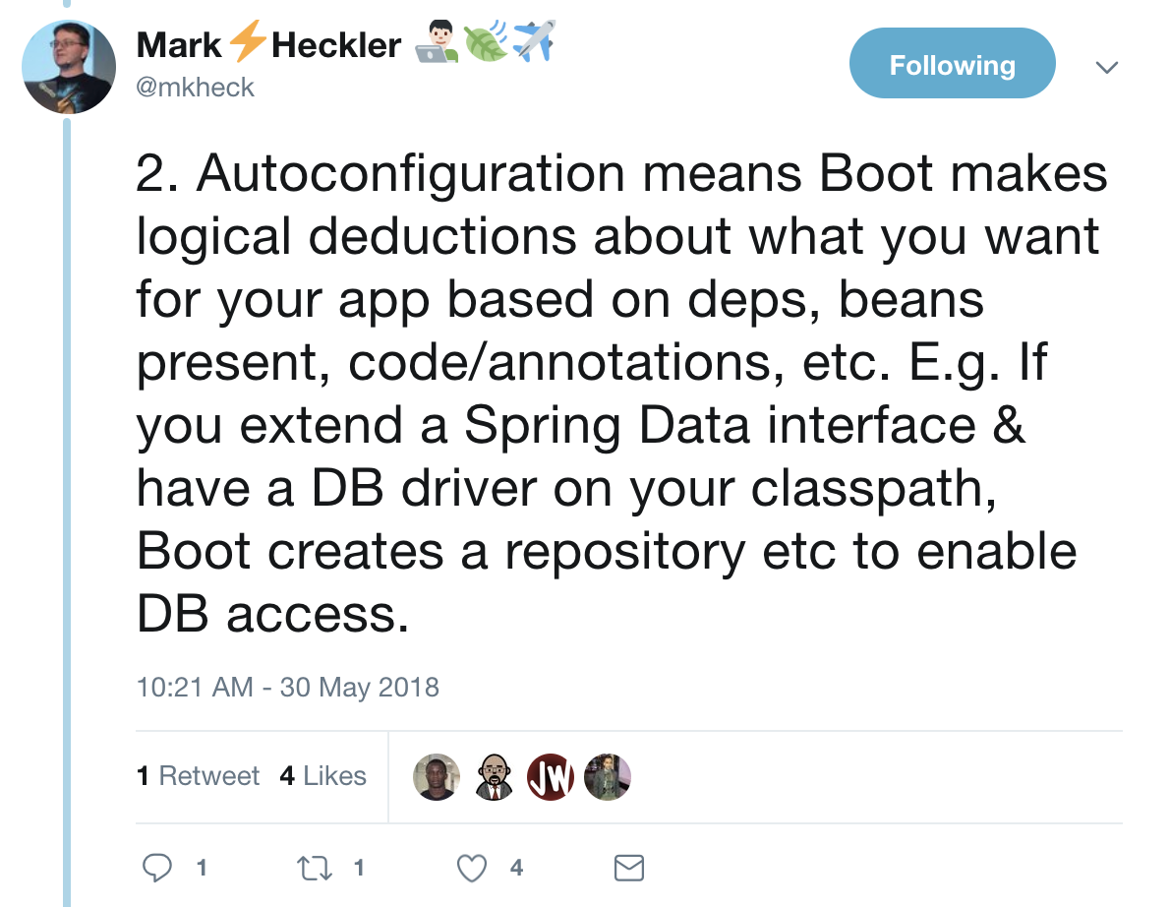

Slide 14
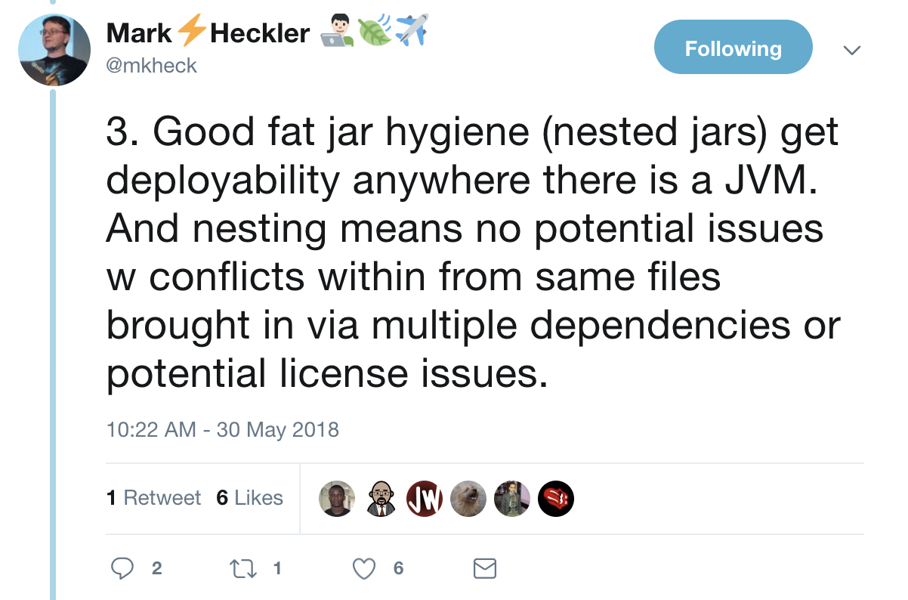

Slide 15
What is Spring Boot?
Spring Boot is a quickstart application context and container launcher for the Spring ecosystem
In essence, it gives you quick access to the Spring Framework by automatically creating an ApplicationContext for you
Without Spring Boot, configuring an ApplicationContext takes time and requires prior knowledge of how Spring works
Spring Boot is “opinionated” in that it also sets up a whole bunch of defaults that the majority of developers would find helpful (like logging for example)
Spring Boot is also…
Fast, with a gentle learning-curve
Easy to Package and Distribute
Production Ready
Notes:
Spring is that lighter weight Java that began to erode the app server market in 2004, and helps straddle that world with the 3rd generation, cloud native platforms.
It even helps 2nd generation customers stuck on older versions of Java EE take advantage of newer Java EE features on their exact same server, often with an upgrade to their server.
Spring is the #1 enterprise Java application development framework by almost any measure. Why do millions of developers choose Spring?
Accomplish any task: support for REST, Web, Websocket, Integration, Batch and Reactive applications
Simplified development: Simple getting started experience requiring minimal configuration
Proven Track Record: In production since 2002, with a focus on maintaining backward compatibility, used heavily by Cloud pioneers and Fortune 2000
Trusted: Java developers rely on Spring for their most demanding applications
Testable: Write clean, testable code against the infrastructure components of your choice
Curated and Modular: Curated set of dependencies while keeping developers in full control of deploying only the parts they need
Deployable: runs on premise, or in public and private cloud platforms
Permissive license: OSS, Apache 2.0 licensed

Slide 16
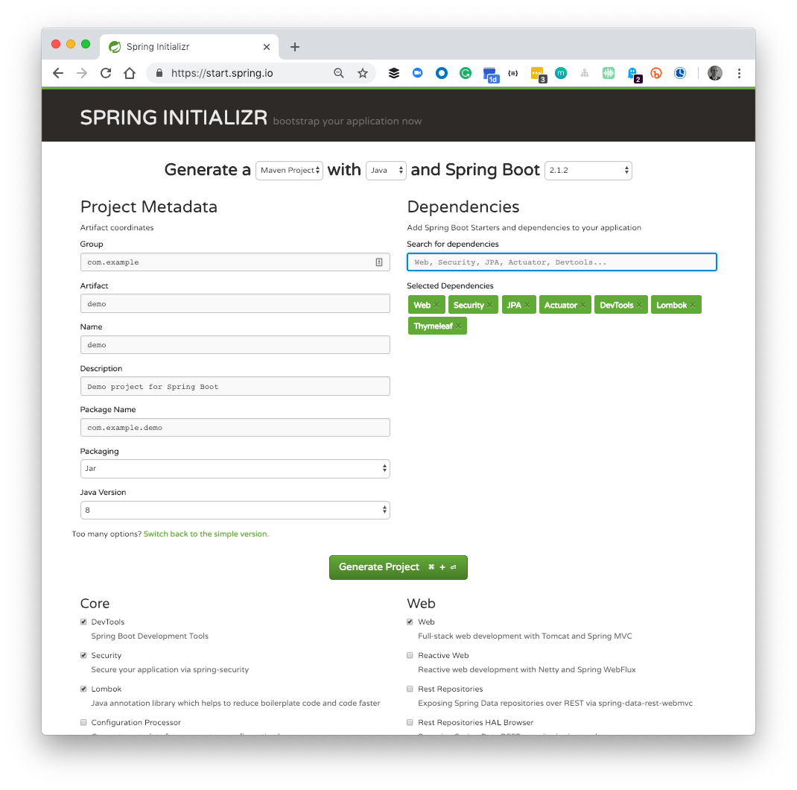
How do I get started?
start.spring.io
The quickest way to get started with Spring Boot is to use the Spring Initializr at start.spring.io
Here you can choose your preferred build system, your preferred language, a Spring Boot version, and choose the “starter” dependencies that you’d like to add to your project
Popular “starter” dependencies include...
Web (Tomcat, Spring MVC, REST)
Reactive Web (Netty, Spring WebFlux)
DevTools (rapid reload for iterative development)
Thymeleaf (web template engine)
JPA (Spring Data, ORM and Hibernate)
Security (Spring Security)
Actuator (Metrics, Admin, Insights)
Whatever you choose, the resulting Zip file will contain a fully configured project that’s ready to go!
You can use Spring Initializr without leaving your favourite IDE! Spring Tool Suite, NetBeans, VSCode and IntelliJ IDEA Ultimate all feature Initializr wizards for starting new projects
Notes:
Spring is that lighter weight Java that began to erode the app server market in 2004, and helps straddle that world with the 3rd generation, cloud native platforms.
It even helps 2nd generation customers stuck on older versions of Java EE take advantage of newer Java EE features on their exact same server, often with an upgrade to their server.
Spring is the #1 enterprise Java application development framework by almost any measure. Why do millions of developers choose Spring?
Accomplish any task: support for REST, Web, Websocket, Integration, Batch and Reactive applications
Simplified development: Simple getting started experience requiring minimal configuration
Proven Track Record: In production since 2002, with a focus on maintaining backward compatibility, used heavily by Cloud pioneers and Fortune 2000
Trusted: Java developers rely on Spring for their most demanding applications
Testable: Write clean, testable code against the infrastructure components of your choice
Curated and Modular: Curated set of dependencies while keeping developers in full control of deploying only the parts they need
Deployable: runs on premise, or in public and private cloud platforms
Permissive license: OSS, Apache 2.0 licensed

Slide 17
What are Spring Boot starters?
start.spring.io
Spring Boot “starters” are dependency packages that work in harmony with the automatic configuration feature in Spring Boot to add additional features to your project
When a compatible library is detected, Spring Boot will set about automatically configuring the components in that starter into the application’s Spring application context
For example, when the “Actuator” starter is detected, a set of REST endpoints are added that give you new insights into your application runtime (such as /actuator/info)
Similarly, when JPA and a Database Driver such as H2 are detected, Spring Boot will automatically configure an in-memory H2 database, a JDBC connection pool and an Entity Manager, all using intelligent defaults
By automatically configuring itself, Spring Boot is relieving the developer from the toil of bootstrapping the application
To find out just how easy it is to get started with Spring Boot, check out the interactive demos at the end of this deck...
Notes:
Spring is that lighter weight Java that began to erode the app server market in 2004, and helps straddle that world with the 3rd generation, cloud native platforms.
It even helps 2nd generation customers stuck on older versions of Java EE take advantage of newer Java EE features on their exact same server, often with an upgrade to their server.
Spring is the #1 enterprise Java application development framework by almost any measure. Why do millions of developers choose Spring?
Accomplish any task: support for REST, Web, Websocket, Integration, Batch and Reactive applications
Simplified development: Simple getting started experience requiring minimal configuration
Proven Track Record: In production since 2002, with a focus on maintaining backward compatibility, used heavily by Cloud pioneers and Fortune 2000
Trusted: Java developers rely on Spring for their most demanding applications
Testable: Write clean, testable code against the infrastructure components of your choice
Curated and Modular: Curated set of dependencies while keeping developers in full control of deploying only the parts they need
Deployable: runs on premise, or in public and private cloud platforms
Permissive license: OSS, Apache 2.0 licensed

Slide 18
How do I run Spring Boot apps?
MyApplication.java
Spring Initializr will add a “Main” class to the project that contains the @SpringBootApplication annotation and some simple boilerplate code, as shown opposite
The Initializr will also add a parent project and a spring-boot plugin dependency to the project’s build file. This allows the build system to build, package and run the application for you with just one simple command… $> ./mvnw spring-boot:run
In the case of applications using the “Web” starter dependency, Spring Boot will run the application within an embedded Tomcat server (packaged in a Jar file also known as Fat Jar)
Bootstrapping a Java project and configuring all these dependencies used to take hours. Now, with Spring Boot, it’s done in minutes, helping developers everywhere to remain productive
@SpringBootApplication
public class MyApplication {
public static void main(String[] args) {
SpringApplication.run(MyApplication.class, args);
}
}
pom.xml
<parent>
<groupId>org.springframework.boot</groupId>
<artifactId>spring-boot-starter-parent</artifactId>
<version>2.1.2.RELEASE</version>
<relativePath/> <!-- lookup parent from repository -->
</parent>
…
<build>
<plugins>
<plugin>
<groupId>org.springframework.boot</groupId>
<artifactId>spring-boot-maven-plugin</artifactId>
</plugin>
</plugins>
</build>
The illustration here is for a Java based Spring Boot application using the Maven build system, however, Kotlin and Gradle are also supported
Notes:
Spring is that lighter weight Java that began to erode the app server market in 2004, and helps straddle that world with the 3rd generation, cloud native platforms.
It even helps 2nd generation customers stuck on older versions of Java EE take advantage of newer Java EE features on their exact same server, often with an upgrade to their server.
Spring is the #1 enterprise Java application development framework by almost any measure. Why do millions of developers choose Spring?
Accomplish any task: support for REST, Web, Websocket, Integration, Batch and Reactive applications
Simplified development: Simple getting started experience requiring minimal configuration
Proven Track Record: In production since 2002, with a focus on maintaining backward compatibility, used heavily by Cloud pioneers and Fortune 2000
Trusted: Java developers rely on Spring for their most demanding applications
Testable: Write clean, testable code against the infrastructure components of your choice
Curated and Modular: Curated set of dependencies while keeping developers in full control of deploying only the parts they need
Deployable: runs on premise, or in public and private cloud platforms
Permissive license: OSS, Apache 2.0 licensed

Slide 19
How does Spring Boot work?
H2ConsoleAutoConfiguration.java
The @SpringBootApplication annotation you saw is in part a collection of other annotations, one of which is @EnableAutoConfiguration which looks in the classpath for a list of auto-configurations to apply and runs them
The classes found are applied based on the rules set within them
In the H2ConsoleAutoConfiguration example opposite, these conditions include “am I a web application?”, and “has my property spring.h2.console been enabled”?
This automatic configuration behaviour can easily be “deactivated” if required using a number of techniques, for example… In the @SpringBootApplication annotation... @SpringBootApplication(exclude={H2ConsoleAutoConfiguration.class}) In a properties file (such as application.properties) spring.autoconfigure.exclude=org.springframework.boot.autoconfigure.h2.H2ConsoleAutoConfiguration
@Configuration
@ConditionalOnWebApplication(type = Type.SERVLET)
@ConditionalOnClass(WebServlet.class)
@ConditionalOnProperty(prefix = "spring.h2.console", name = "enabled", havingValue = "true", matchIfMissing = false)
@EnableConfigurationProperties(H2ConsoleProperties.class)
public class H2ConsoleAutoConfiguration {
private final H2ConsoleProperties properties;
public H2ConsoleAutoConfiguration(H2ConsoleProperties properties) {this.properties = properties;}
@Bean
public ServletRegistrationBean<WebServlet> h2Console() {
String path = this.properties.getPath();
String urlMapping = path + (path.endsWith("/") ? "*" : "/*");
ServletRegistrationBean<WebServlet> registration = new ServletRegistrationBean<>(new WebServlet(), urlMapping);
H2ConsoleProperties.Settings settings = this.properties.getSettings();
//Omitted code
return registration;
}
}
Notes:
Spring is that lighter weight Java that began to erode the app server market in 2004, and helps straddle that world with the 3rd generation, cloud native platforms.
It even helps 2nd generation customers stuck on older versions of Java EE take advantage of newer Java EE features on their exact same server, often with an upgrade to their server.
Spring is the #1 enterprise Java application development framework by almost any measure. Why do millions of developers choose Spring?
Accomplish any task: support for REST, Web, Websocket, Integration, Batch and Reactive applications
Simplified development: Simple getting started experience requiring minimal configuration
Proven Track Record: In production since 2002, with a focus on maintaining backward compatibility, used heavily by Cloud pioneers and Fortune 2000
Trusted: Java developers rely on Spring for their most demanding applications
Testable: Write clean, testable code against the infrastructure components of your choice
Curated and Modular: Curated set of dependencies while keeping developers in full control of deploying only the parts they need
Deployable: runs on premise, or in public and private cloud platforms
Permissive license: OSS, Apache 2.0 licensed

Slide 20
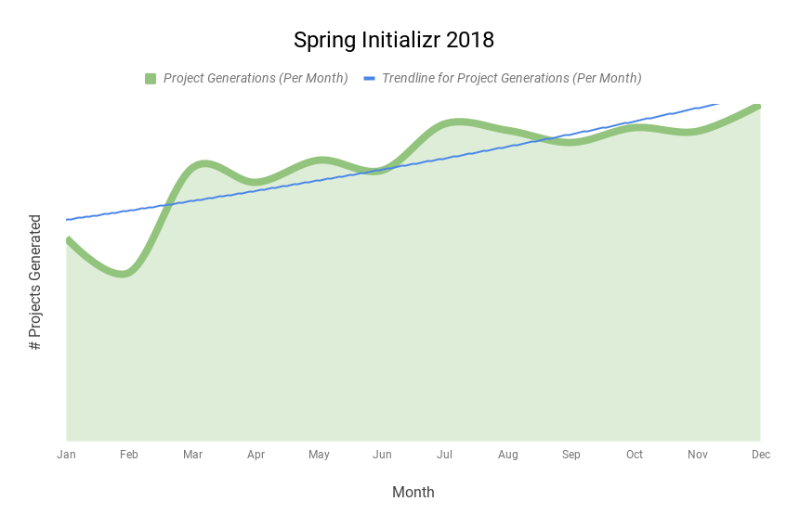
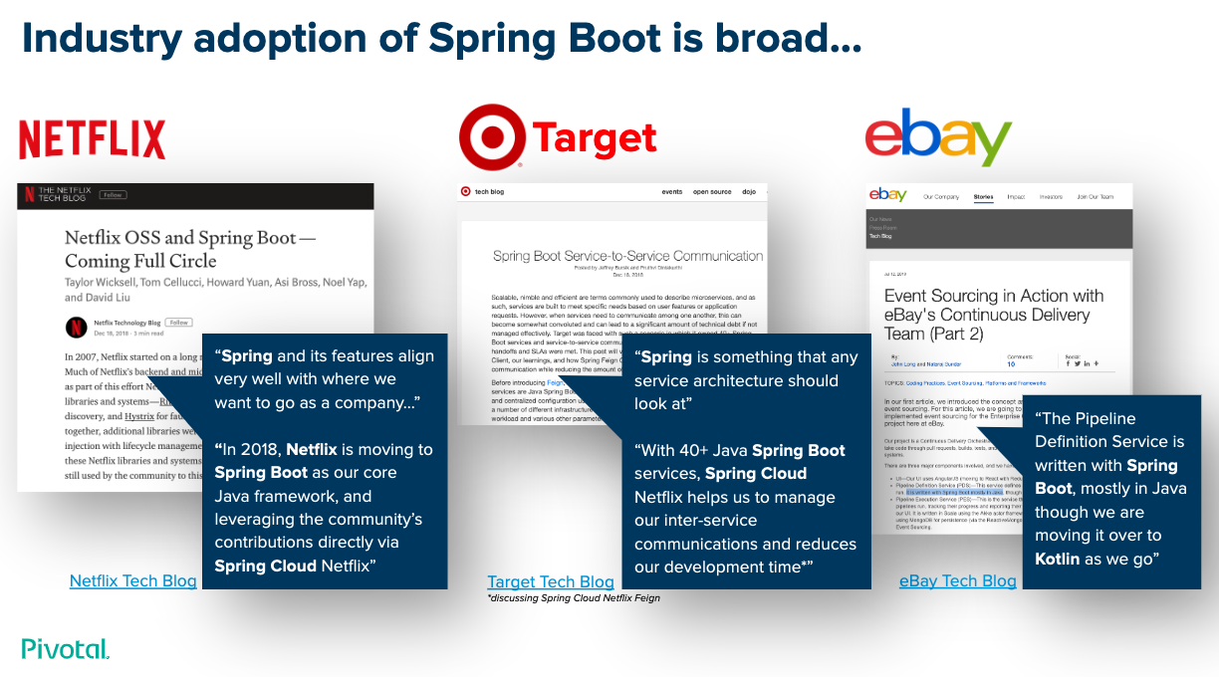
Why is Spring Boot so popular?
Many surveys indicate that Spring Boot is used by approximately 4 in 10 developers; no other platform comes close
Spring Boot is great for writing 12-factor applications, and works really well in the cloud, especially when used in conjunction with Spring Cloud’s starters
Developers 💚Spring Boot because it’s easy to start and easy to use, but gives them full control when they want it and flexibility when they need it
Spring Boot “just works”, with hundreds of curated and tested dependencies right out of the box - greatly reducing the guesswork, wiring and troubleshooting required
Executable JAR packaging means that applications can truly “run-anywhere” there’s a compatible JVM
In 2018 Spring Initializr generated over 10 million Spring projects!
For more on the popularity and adoption of Spring, including endorsements, see Spring Boot Adoption
Notes:
Spring is that lighter weight Java that began to erode the app server market in 2004, and helps straddle that world with the 3rd generation, cloud native platforms.
It even helps 2nd generation customers stuck on older versions of Java EE take advantage of newer Java EE features on their exact same server, often with an upgrade to their server.
Spring is the #1 enterprise Java application development framework by almost any measure. Why do millions of developers choose Spring?
Accomplish any task: support for REST, Web, Websocket, Integration, Batch and Reactive applications
Simplified development: Simple getting started experience requiring minimal configuration
Proven Track Record: In production since 2002, with a focus on maintaining backward compatibility, used heavily by Cloud pioneers and Fortune 2000
Trusted: Java developers rely on Spring for their most demanding applications
Testable: Write clean, testable code against the infrastructure components of your choice
Curated and Modular: Curated set of dependencies while keeping developers in full control of deploying only the parts they need
Deployable: runs on premise, or in public and private cloud platforms
Permissive license: OSS, Apache 2.0 licensed

Slide 21

What about the Cloud?
Spring Cloud extends Spring Boot’s “convention over configuration” approach into the cloud
Spring Cloud provides a set of tools or “common patterns” that reduce complexity and allow developers to quickly assemble distributed systems
These common patterns will be familiar to many and include…
Service Discovery
Externalised Configuration
Circuit Breaker
API Gateway
Client Side Routing & Load Balancing
Distributed Tracing
Admin Tasks, API Contracts, Streams, Connectors
….and much more
Spring Cloud is the logical next step for anyone scaling out microservices or distributed systems built with Spring Boot
Config
Discovery
Tracing
Breaker
Gateway
Connector
Notes:
Building distributed systems doesn't need to be complex and error-prone. Spring Cloud offers a simple and accessible programming model to the most common distributed system patterns, helping developers build resilient, reliable, and coordinated applications. Spring Cloud is built on top of Spring Boot, making it easy for developers to get started and become productive quickly.
Spring Cloud OSS provides the It’s platform aware and provides an integrated spectrum of opinions, convention over configuration
Building on Spring Boot and Spring Security OAuth2 we can quickly create systems that implement common patterns like single sign on, token relay and token exchange.
configuration management, service discovery, circuit breakers, intelligent routing, micro-proxy, control bus, one-time tokens, global locks, leadership election, distributed sessions, cluster state).

Slide 22
What about Production?
Pivotal Application Service (PAS) is the best place to run Spring Boot applications; just look at all the built-in features...
Java Buildpack with autoconfiguration, a choice of JVM variants, a hardened Ubuntu OS and OCI containerization
TAS Container Management scales up and down with ease
TAS Apps Manager is a graphical UI dashboard which shows your app’s Actuators, ENV vars, Traces and more
TAS Marketplace allows on-demand provisioning of highly-available backing services such as Databases, Messaging etc.
Spring Cloud Services brings popular Spring Cloud features to the marketplace including registry and config
TAS UAA allows single-sign-on and consolidation of LDAP, SAML and OAuth for comprehensive application security
TAS Routing gives your customers instant and secure access to your application with no firewalls, dns or tickets
TAS Networking & Isolation Segments allows you to easily configure application networking permissions
Notes:
Things we do for Spring Dev’s on PCF…
Java Buildpack - auto-reconfiguration, JVM choice and versioning, OCI containerisation, hardened OS image (Ubuntu)
PCF Container Management - scale up, scale down, blue / green as standard, auto-restart, restaging, security
PCF Apps Manager - graphical UI, actuator integration, traces, threads, route mappings, ENV VARS, etc.
PCF Routes - accessing your apps from outside is simple, load-balanced automatically, no DNS, no Firewalls, no Admins, no Tickets!
PCF Log Aggregator - unified logging across all instances of all apps!
PCF Marketplace - services, services, services, no DNS, no Firewalls, no Admins, no Tickets!
Spring Cloud Services - HA versions of service registry, config server, hystrix dashboard, available in the marketplace.
PCF Tasks - run one off tasks in the cloud, and schedule repetitive tasks!
PCF Metrics - graphs, charts and metrics, time series style, slice, dice and insights on all your apps.
PCF UAA - unify legacy enterprise authentication, use modern schemes like OAuth in your apps

Slide 23

Let’s try it...

Slide 24

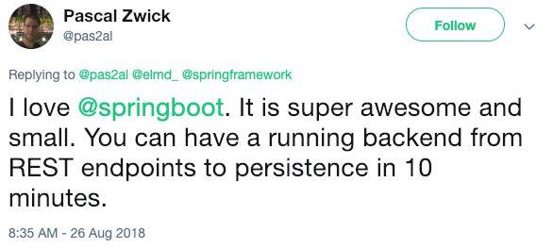
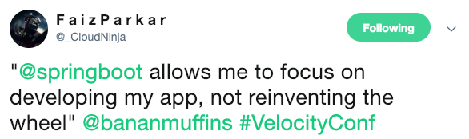
What others are saying...
DEVELOPERS
“Spring and its features align very well with where we want to go as a company...”
“In 2018, Netflix is moving to Spring Boot as our core Java framework, leveraging the community’s contributions via Spring Cloud Netflix”
Netflix Blog
Tweet

Slide 25

Transforming How The World Builds Software
© Copyright 2019 Pivotal Software, Inc. All rights Reserved.

